Slide 1
Occupancy models

Slide 2
The problem of occupancy
We want to understand what controls presence or absence of individuals or categories, e.g., invasive species within different communities, seedlings within distance bins, nitrogen fixers within soil types.
We have a problem with interpreting absence:
The individual/category is truly absent.
The individual is present but we fail to observe it (i.e, a false negative)
We often want to explain spatial and temporal variation in the observations using a model.
We need to estimate uncertainty due to
The failure of our model to truly portray spatial and temporal variation in occupancy.
The uncertainty in our observations arising because we fail to observe occupancy without error.

Slide 3
The willow tit
Birds on the alpine landscapes of Switzerland. We are interested in how landscape characteristics influence habitat use by a rare bird, the willow tit. There are M sites and we search each site J times looking and listening for the bird. We take observations for each site for each time period recording 0 if the bird was not observed and 1 if it was observed.
Our hypothesis was that the probability that the i^{th} site was occupied was related to its elevation and forest cover, both being quantitative variables. We must account for the fact that a string of J 0’s for all visits to a site could mean two things: the bird was absent from the site, or the bird was present and unobserved. If we fail to account for these differences, we will underestimate occupancy.
Data:
yi = the number of times that a bird was detected at site i given Ji attempts to find the bird plus site covariates

Slide 4
Accounting for detectability
Define the state variable z_{i} as describing the true state of a site:
z_{i} = 0 if the site is unoccupied
z_{i} = 1 if the site is occupied
Note that each site can take on only 1 of the two states and it is presumed to be in that state throughout the sampling period.
Thus, we can model z_{i} as:

Slide 5
Accounting for detectability
Let p = the probability that we would detect a bird if it is present on a site.
Thus, the probability of detecting a bird on a given visit to a site is:
z *p= 0 if the site is not occupied
z * p= p if the site is occupied

Slide 6
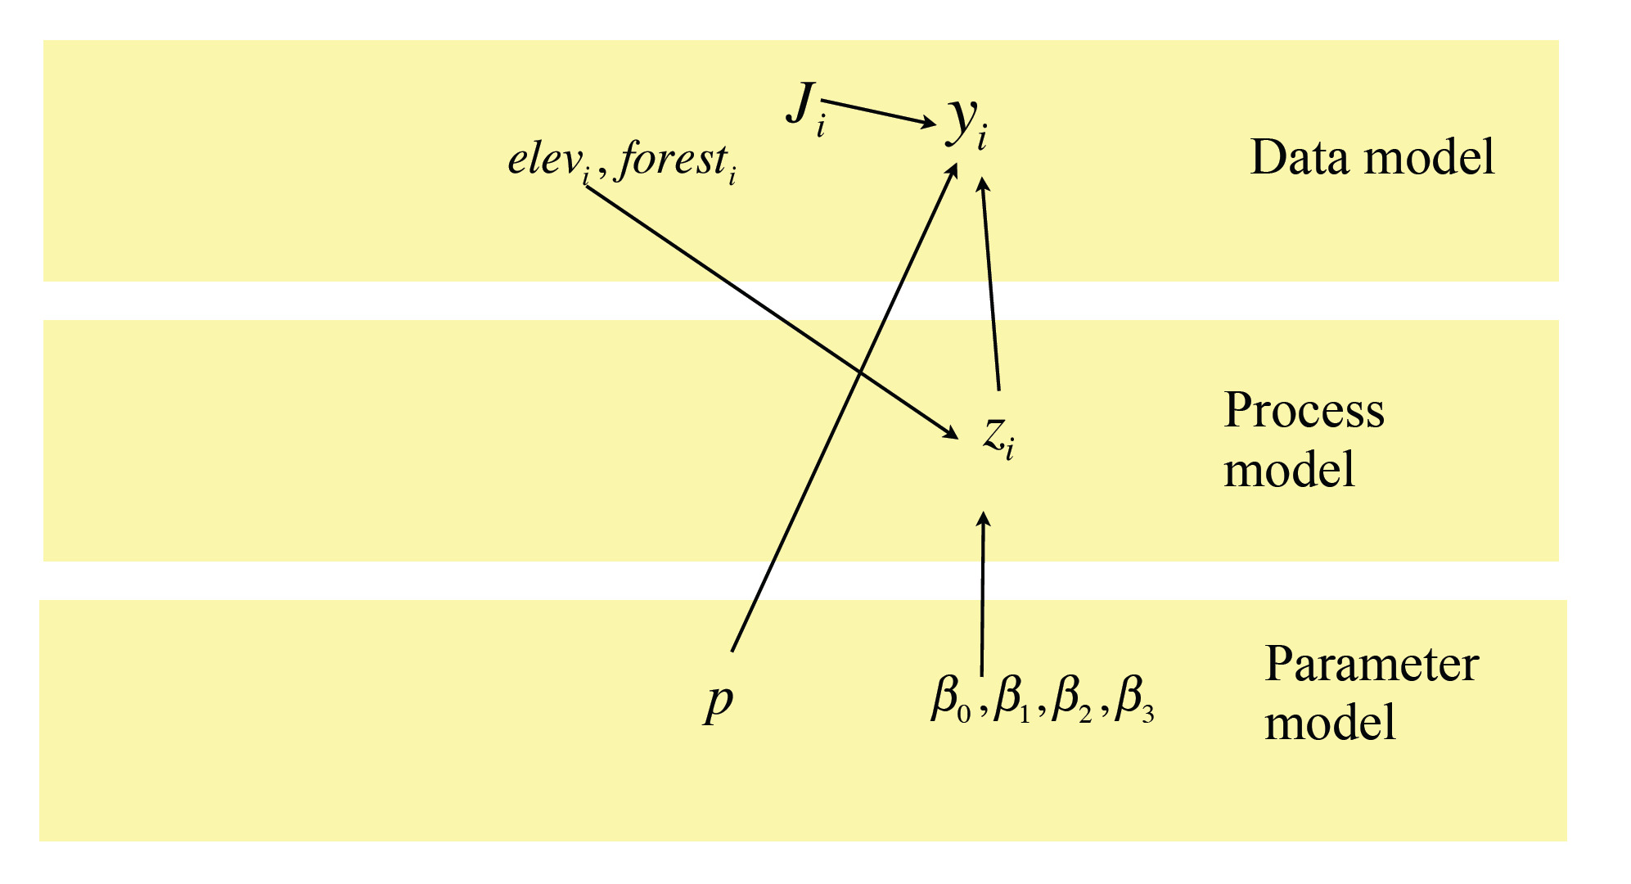

Slide 8
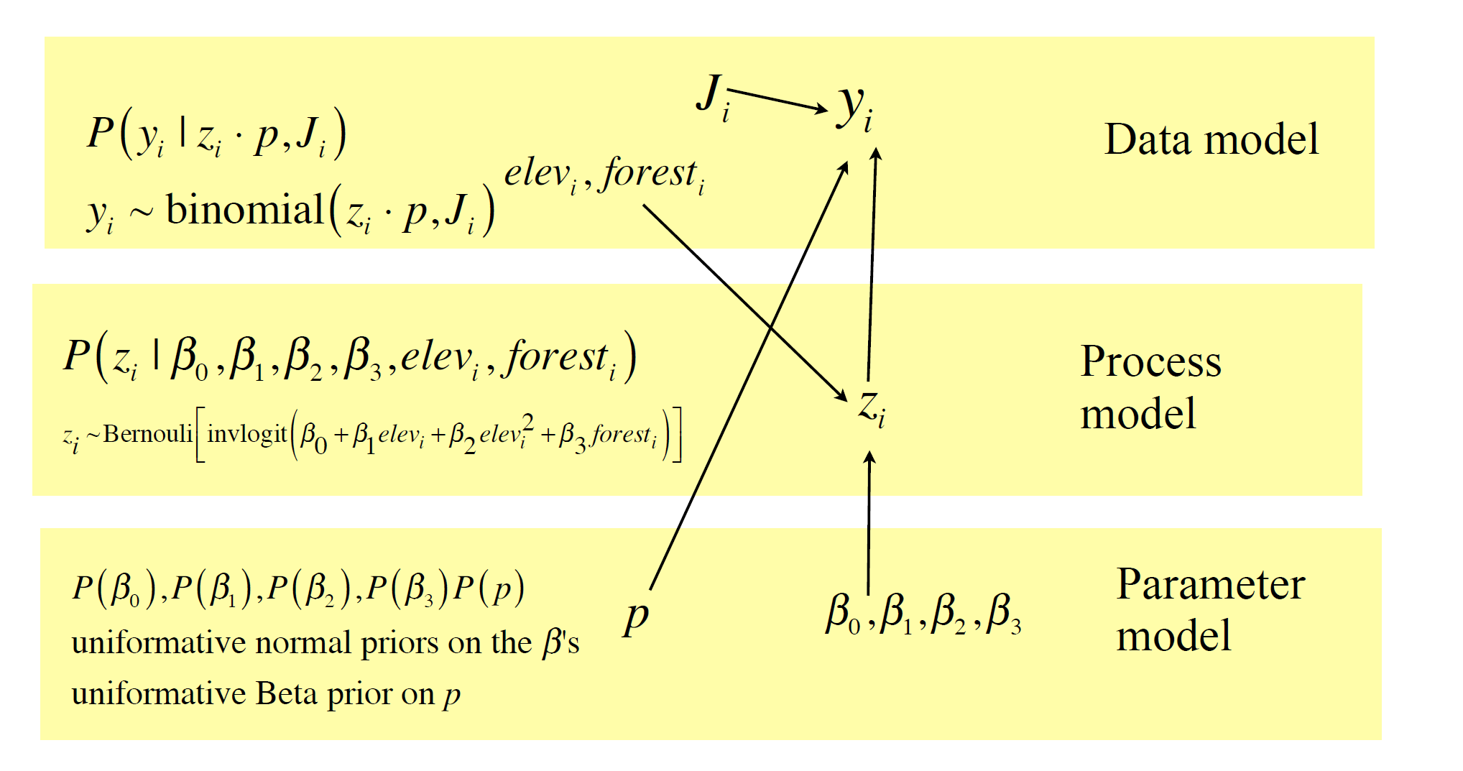

Slide 9
model {
# priors
# p is probability of detection which we assume to be uniform (or beta)
p ~ dunif(0,1)
b0 ~ dnorm(0,.000001)
b1 ~ dnorm(0,.000001)
b2 ~ dnorm(0,.0000001)
b3 ~ dnorm(0,.0000001)
for(i in 1:M){ # M=number of sites
z[i] ~ dbin(psi[i],1) # pred. occupancy
logit(psi[i]) <- b0 + b1*elev[i] + b2*elev2[i] + b3*forest[i]
tmp[i]<-z[i]*p #pred number obs * prob. detection
y[i] ~ dbin(tmp[i],n[i]) # visits. accounting for # of non-missing observations
}
} #end of model

Slide 10
Courtesy McCarthy 2007
Kristen Parris studied controls on the distribution of tree frogs in the riparian zone of streams on the east coast of sub-tropical Australia.
Multiple surveys were conducted at 64 sites using 2 observation methods, visual searches at night and auditory searches for responses to taped calls. We assume the presence /absence of frogs at a site does not change across multiple surveys.
Presence / absence of frogs was modeled as a function of 1) stream size 2) the presence or absence of palms at the site (an indicator of mesic or xeric conditions) and 3) the interaction between palms and stream size.
Data are the total number of times frogs were detected using each method for each site and the number of surveys for each site.

Slide 11
Tree frog example
x1=vector of obs. of stream size
x2=vector of obs of palms (0,1)
y^{visual} =vector of obs. at each site by eye
y^{auditory} = vector of obs. at each site by ear
n^{visual} =vector of number of visual surveys
n^{auditory} = vector of number of auditory surveys
z_{i}= the true state of the patch (1=occupied, 0=absent)

Slide 12
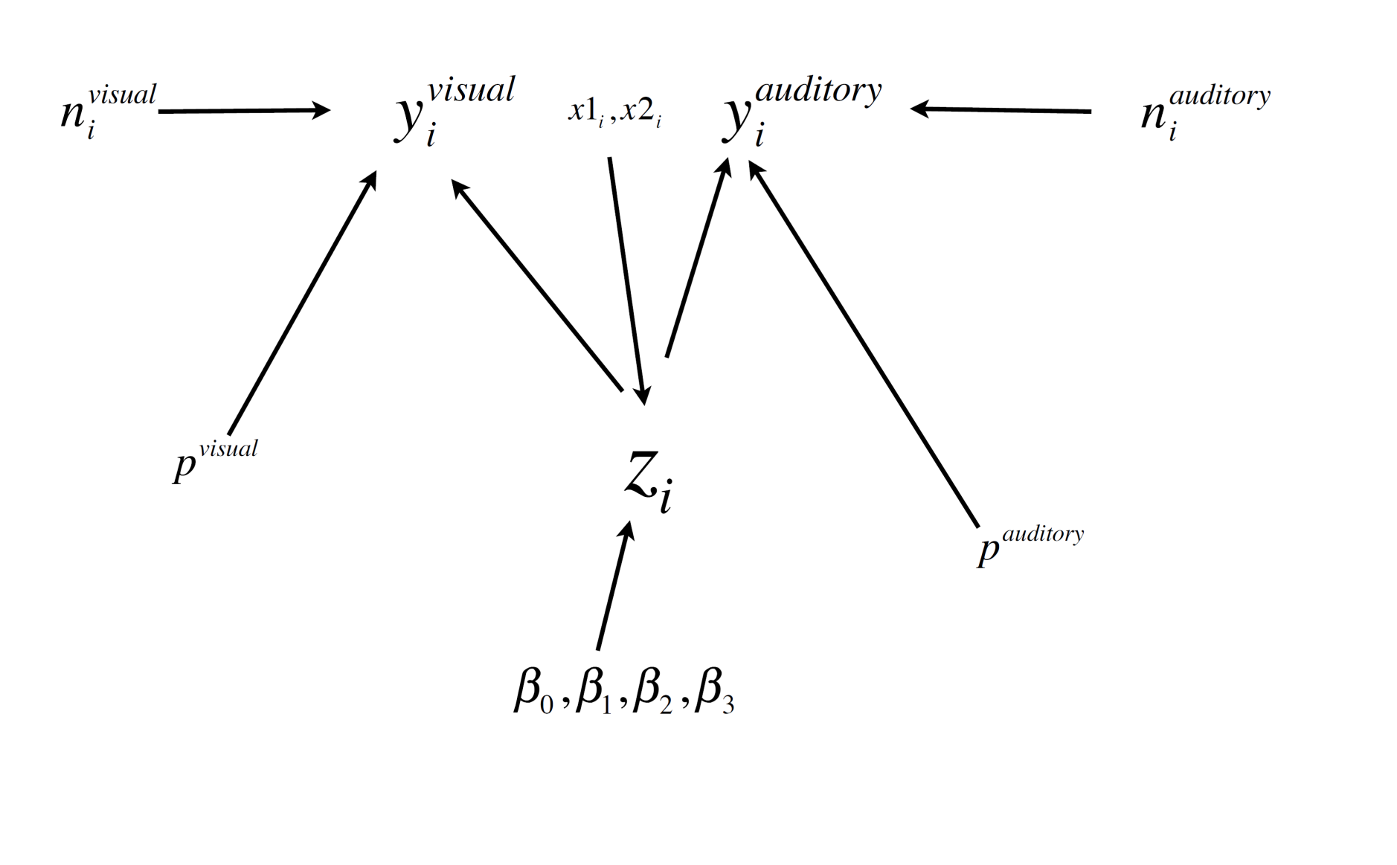

Slide 13
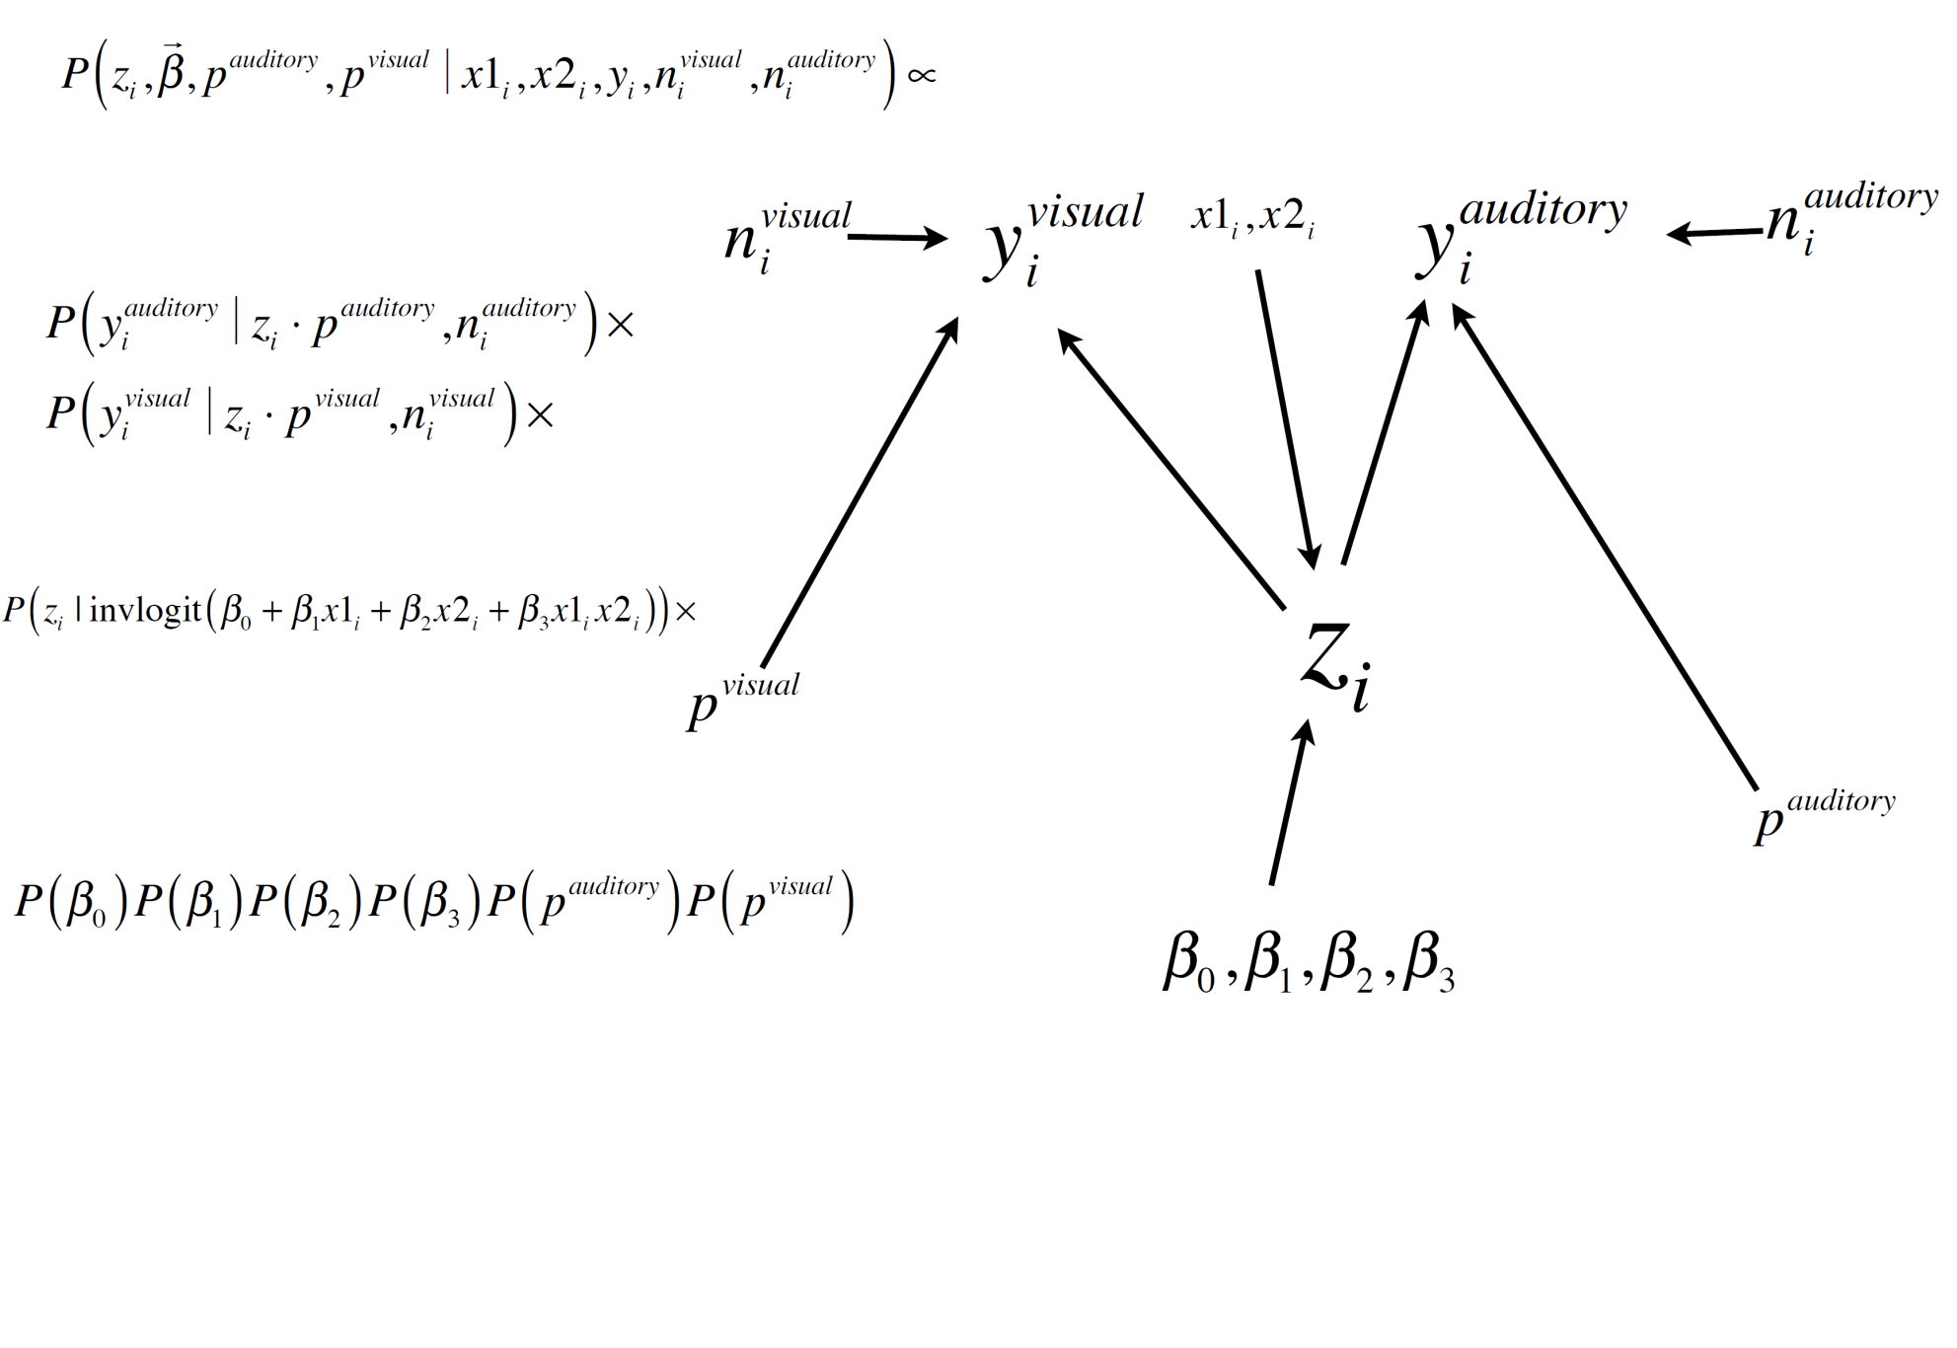

Slide 14
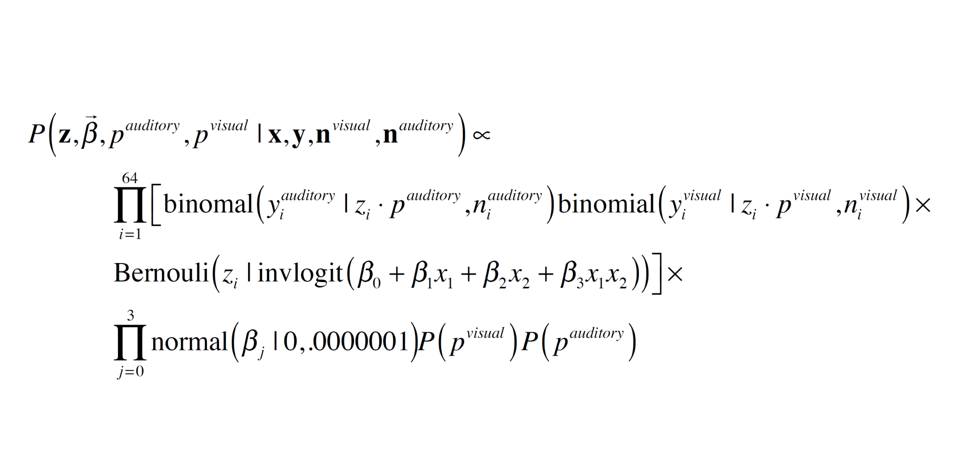

Slide 15
model{
a ~ dnorm(0, 1.0E-6) # uninformative priors for the variables
b[1] ~ dnorm(0, 1.0E-6)
b[2] ~ dnorm(0, 1.0E-6)
b[3] ~ dnorm(0, 1.0E-6)
p.visual ~ dunif(0, 1) # detection probabilities when the species is present
p.auditory ~ dunif(0, 1)
mLnCV <- mean(LnCV[]) # average catchment volume
for (i in 1:64) # for each of the 64 sites
{
# probability of presence using centered data
phi[i] <- ilogit(a + b[1]*(LnCV[i] - mLnCV) + b[2]*palms[i] + b[3]*(LnCV[i] -mLnCV))*palms[i]
z[i] ~ dbern(phi[i]) # actual, latent presence at the site, 0 or 1
y.visual[i] ~ dbin(p.visual*z[i], n.visual[i]) # number eye detections with
y.auditory[i] ~ dbin(p.auditory*z[i], n.auditory[i]) # number of ear detections
}
}

Slide 16
Important tricks for implementing occupancy models.
• Initialize all latent quantities i.e., all zi = 1.The phi’s don’t need to be initialized if you calculate them en-route to the zi
• You may need to bound phi[i] to be 0 < phi[i] < 1 to avoid errors, i.e.:
phi[i] <- max(min(ilogit(a + b[1]*(LnCV[i] - mLnCV) + b[2]*palms[i] + b[3]*(LnCV[i] -mLnCV))*palms[i],.0000001),.999999)

Slide 17
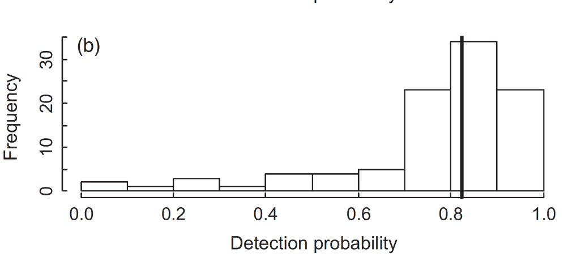
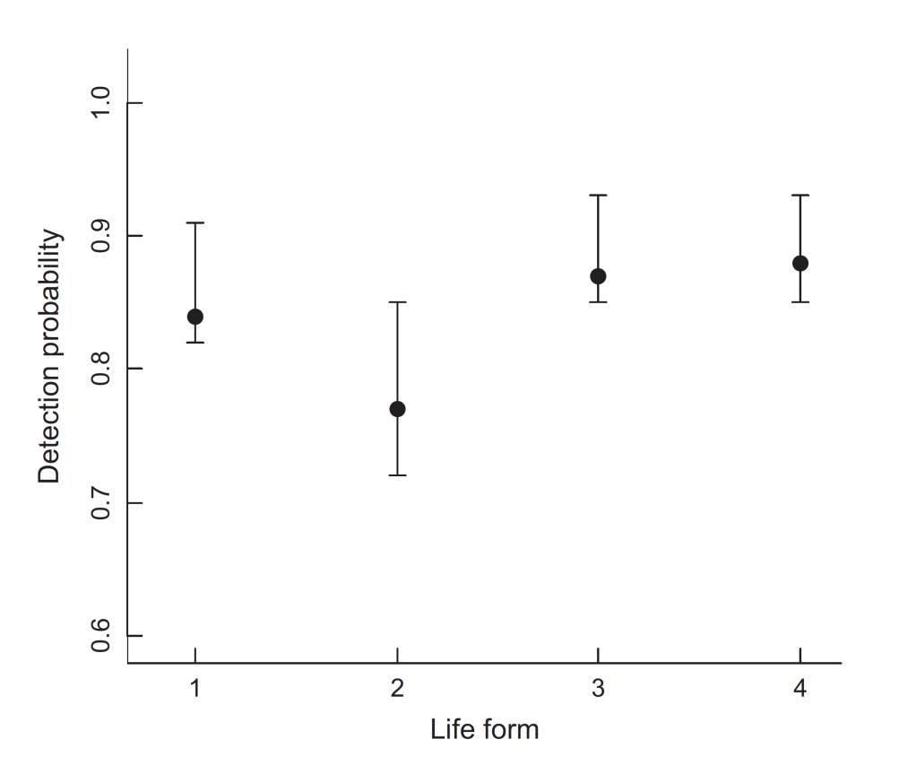
forb
shrub
tree
grass

Slide 18
# Likelihood
for (i in 1:nsites) {# Loop over sites
for(k in 1:nspecies){# Loop over species
# True state model for the partially observed true state
# True occupancy z at site i for species k
z[i,k] ~ dbern(psi[i,k])
logit(psi[i,k]) <- lpsi.lim[i,k]
lpsi.lim[i,k] <- min(999, max(-999, lpsi[i,k])) # bound
# the effects of elevation and average occupancy differ by species
lpsi[i,k] <- alpha0[k] + alpha1[k] * elev[i] + alpha2[k] * elev2[i]
for (j in 1:nreps){# Loop over surveys
# Observation model for the actual observations
# Detection-nondetection at i and j
y[i,k,j] ~ dbern(mu.p[i,k,j])
mu.p[i,k,j] <- z[i,k] * p[i,k,j]
# probability of detection
logit(p[i,k,j]) <- beta1[k] + beta2[k] * DATES[i,j] + beta3[k] * pow(DATES[i,j], 2)
}
}}
Notes:
DATES= date in which the survey was conducted….

Slide 19
Mark-recapture models

Slide 20
State-space models: Hierarchies for dynamic processes
And secret weapons of Bayesian masters

Slide 21
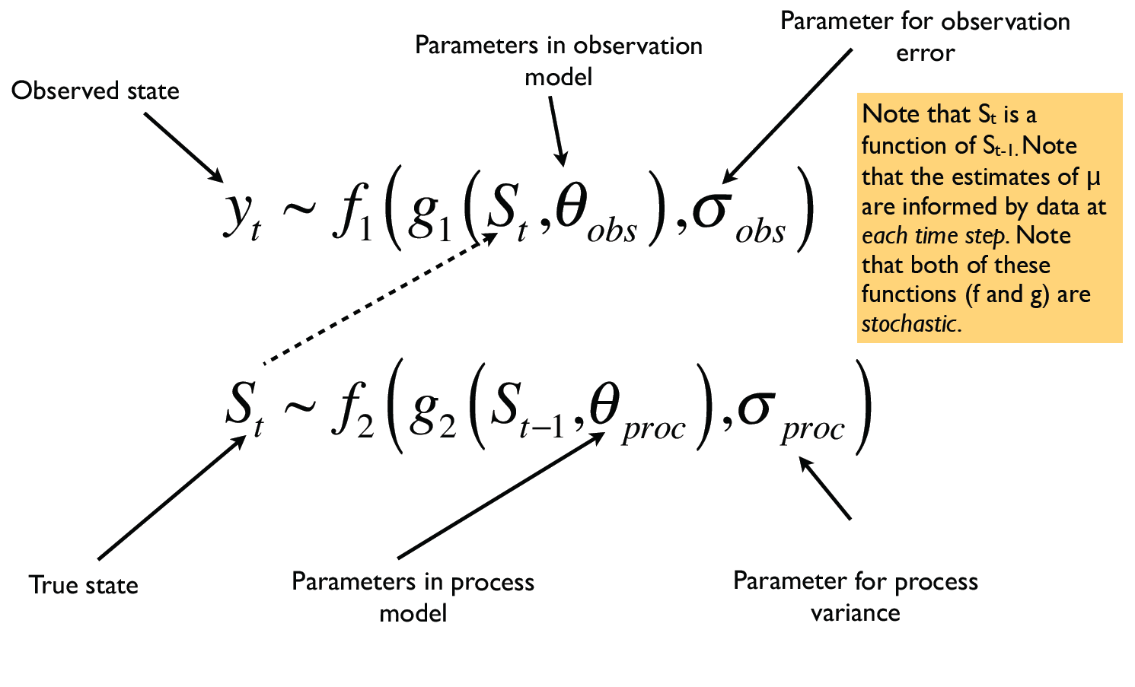
State-space models are hierarchical models that include time
Notes:
States at time t are updated at each time step based on data from the state in last period (S t-1).

Slide 22
Why state-space models?

Slide 23
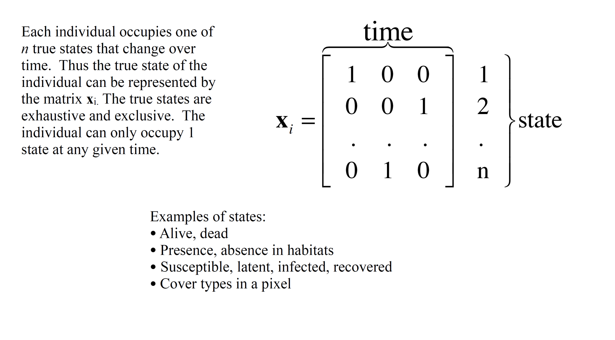
Occupancy as a state-space model
Notes:
That is it can only be alive, dead etc….

Slide 24
Occupancy as a state-space model

Slide 25
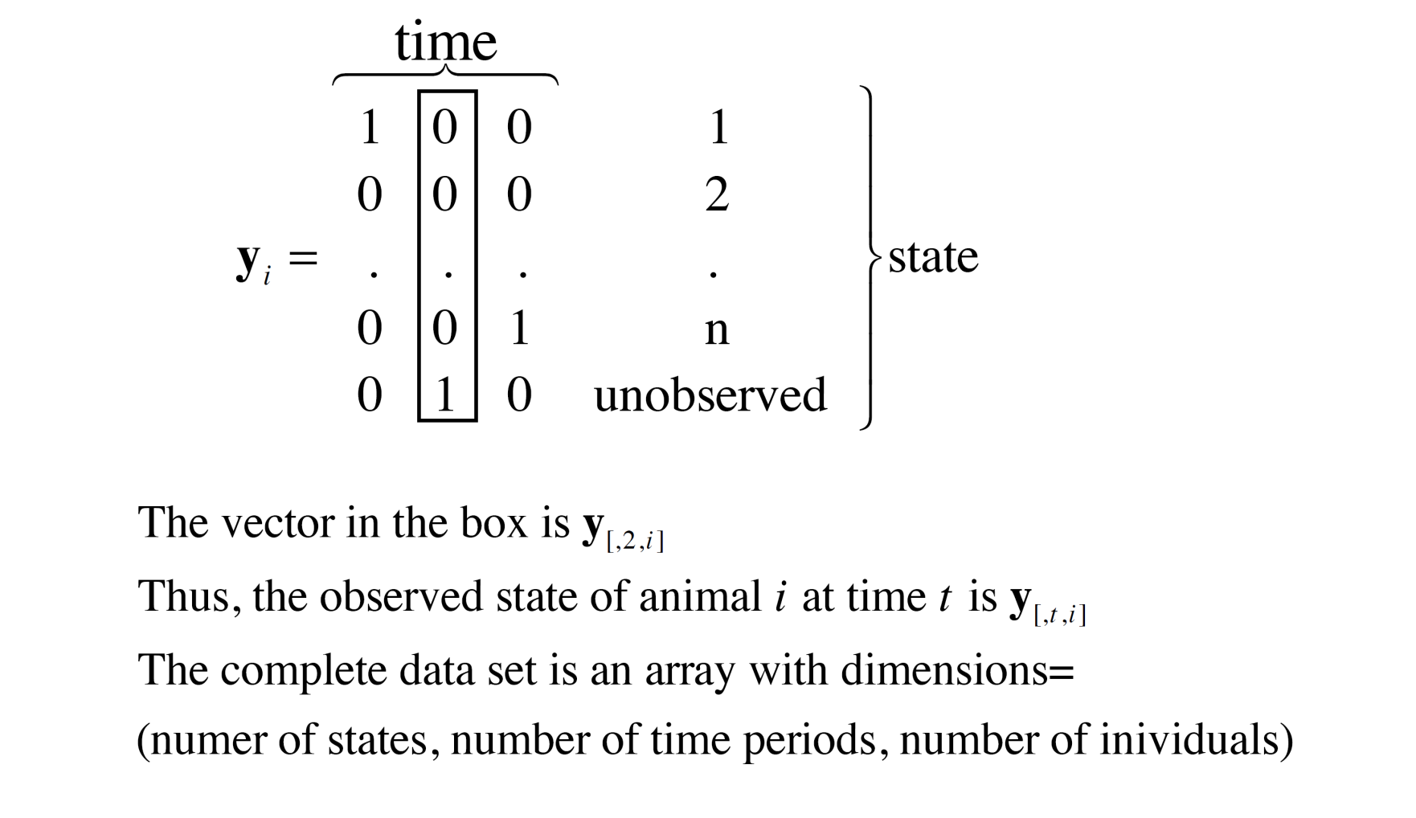
Data structure and notation
Notes:
Arrays with number of states (dead/alive, number of time periods, number of individuals….)

Slide 26
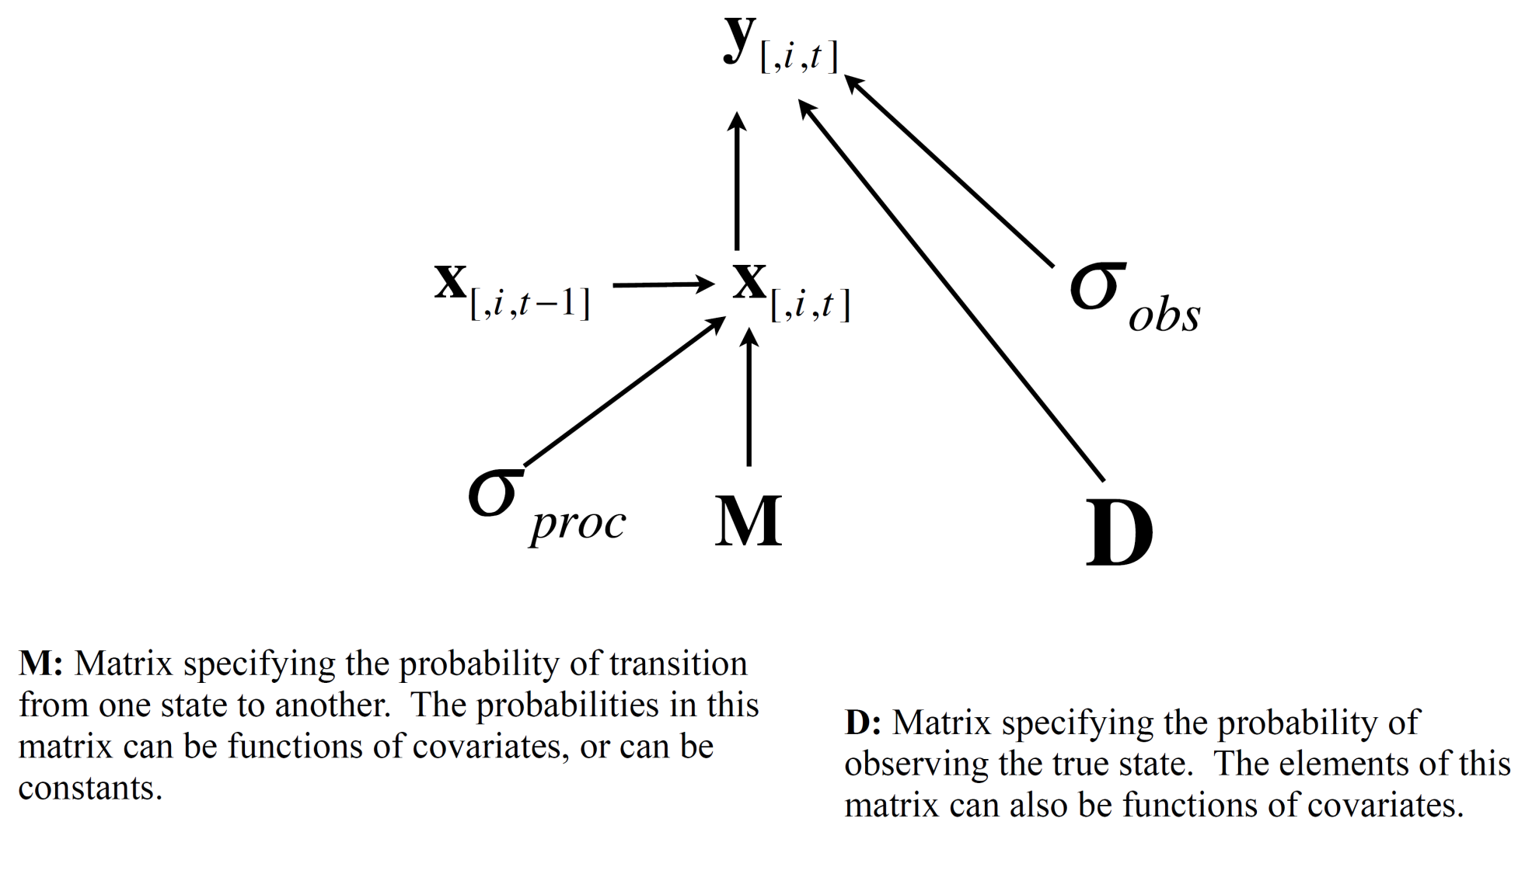
The general state-space framework

Slide 27
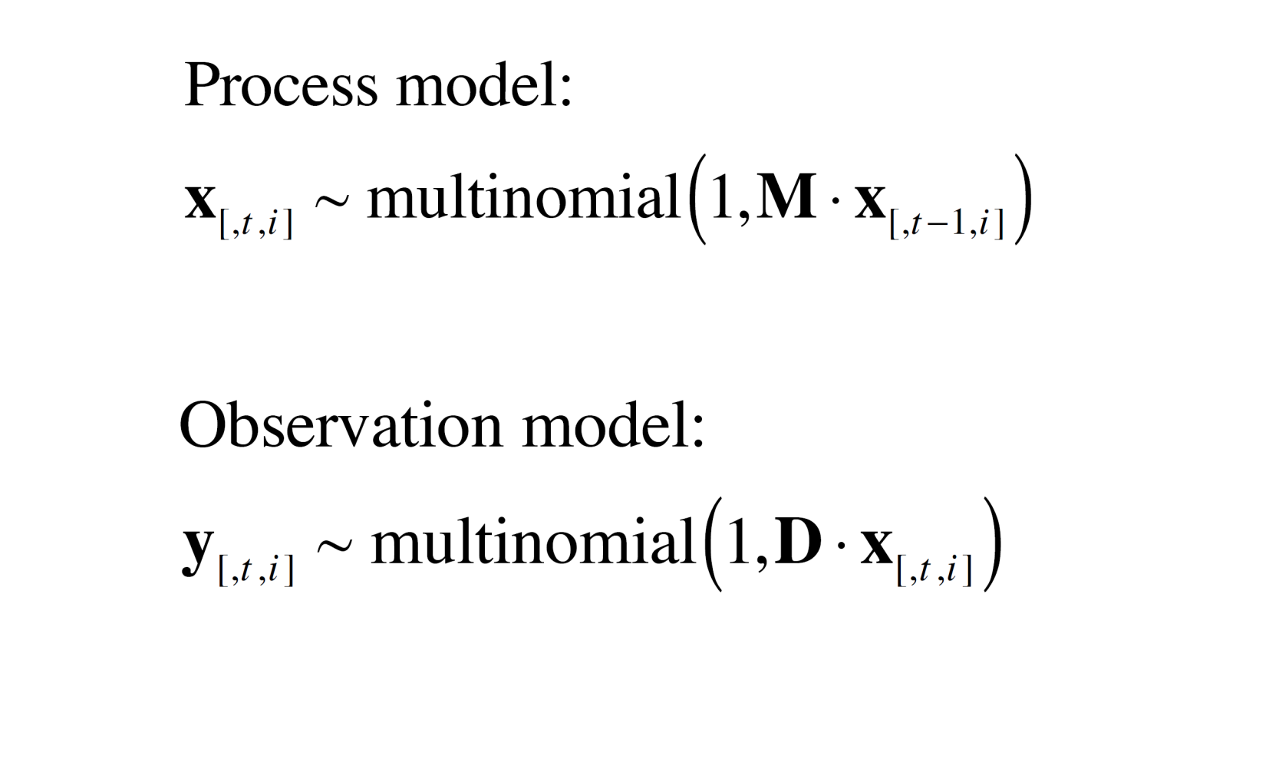
The general state-space framework

Slide 28
Some examples using mark-recapture data
Individuals are captured, marked and recaptured (or re-observed) at several points in time.
We want to estimate parameters governing state transitions, i.e. probabilities of survival, movements among habitats, transmission of disease, etc.
We have the problem of estimating these parameters in the face of incomplete observations--not all states are observed in all individuals at all sampling periods.
The many idiosyncrasies among methods for observation and the biology of states of interest demand a flexible, principles-based approach to analysis.
The data on each individual (i.e., the yi ) are known as capture histories.

Slide 29
The simplest case
We want to estimate the probability of survival, θ,and the probablity of detection given that the animal is alive, p_{a} .
There is one state (alive or not alive) represented by a vector of 1's and 0's. So, the true state for a single individual over four sampling periods would be represented as:
x[,t ,i ] =[ 1 1 1 0]
The only information we get about the individual is by recapturing it, which can only occur if it is alive. The capture history might be something like:
y[,t ,i ] = [1 0 1 0]
The problem is how to interpret 0’s at the end of the capture history. Is the animal dead or did we simply fail to observe it?

Slide 30
detection
survival

Slide 31
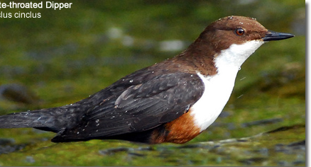
Data: The European dipper
Data for 294 birds over 7 years, need first year observed for each individual
ind | first_yr | h1 | h2 | h3 | h4 | h5 | h6 | h7
1 | 1 | 1 | 1 | 1 | 1 | 1 | 1 | 0
2 | 1 | 1 | 1 | 1 | 1 | 1 | 0 | 0
3 | 1 | 1 | 1 | 1 | 1 | 0 | 0 | 0
4 | 1 | 1 | 1 | 1 | 1 | 0 | 0 | 0
5 | 1 | 1 | 1 | 0 | 1 | 1 | 1 | 0
6 | 1 | 1 | 1 | 0 | 0 | 0 | 0 | 0
7 | 1 | 1 | 1 | 0 | 0 | 0 | 0 | 0
8 | 1 | 1 | 1 | 0 | 0 | 0 | 0 | 0
9 | 1 | 1 | 1 | 0 | 0 | 0 | 0 | 0
10 | 1 | 1 | 1 | 0 | 0 | 0 | 0 | 0

Slide 32
# Mark-recapture analysis for female European Dippers
y<-read.csv('dippers.csv')
First<-y$first_yr
birds = nrow(y)
years =7
y=as.matrix(y[1:birds,3:9]) # extracts obs.
y <- matrix(y, ncol = ncol(y), dimnames = NULL) # formatting
# need to provide initial values for each bird-year. NA s for birds yet to be observed
# 1’s for everything else.
alive=matrix(NA,ncol=7,nrow=birds)
for (i in 1:birds) # for each bird
{ alive[i,First[i]] = 1 # 1 means it is alive the first time it was seen
for (j in (First[i]+1):years) alive[i,j]=1 }
inits=list(
list(alive=alive, surv=.5, resight = .5),
list(alive=alive, surv=.1, resight = .9),
list(alive=alive, surv=.7, resight = .2) )

Slide 33
# Mark-recapture analysis for female European Dippers
model
{
for (i in 1:N) # for each bird
{
alive[i, First[i]] ~dunif(0.999,1) # 1 means it is alive the first time it was seen
for (j in First[i]+1:Years) # for each year after the first
{
# palive = prob of remaining alive (=0 if previously dead, =surv if alive)
palive[i,j] <- surv * alive[i, j-1]
# determine whether it is alive
alive[i,j] ~ dbern(palive[i,j])
# probability of resighting depends on whether it is alive
psight[i,j] <- resight * alive[i, j]
# actual resighting determined randomly
Y[i, j] ~ dbern(psight[i,j])
}
}
# Uninformative priors for survival and resighting rates
surv ~ dunif(0, 1) # uninformative
resight ~ dunif(0,1) # resighting rate - uninformative
}

Slide 34
A more advanced example

Slide 35
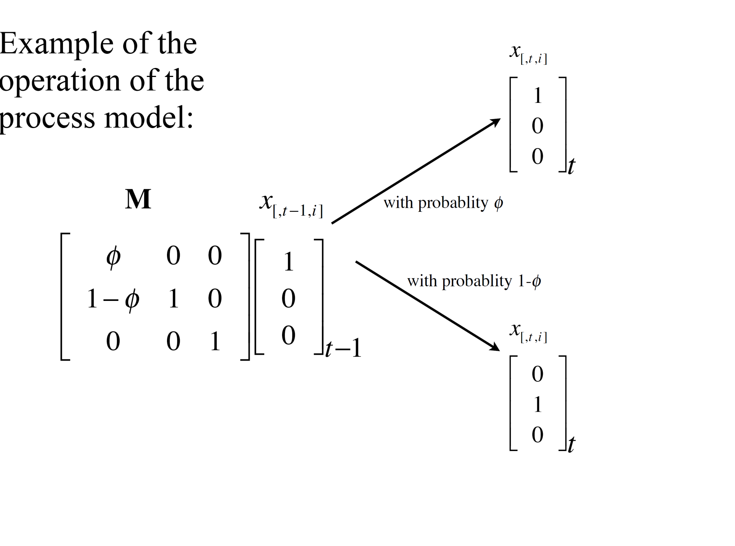
Survival

Slide 36
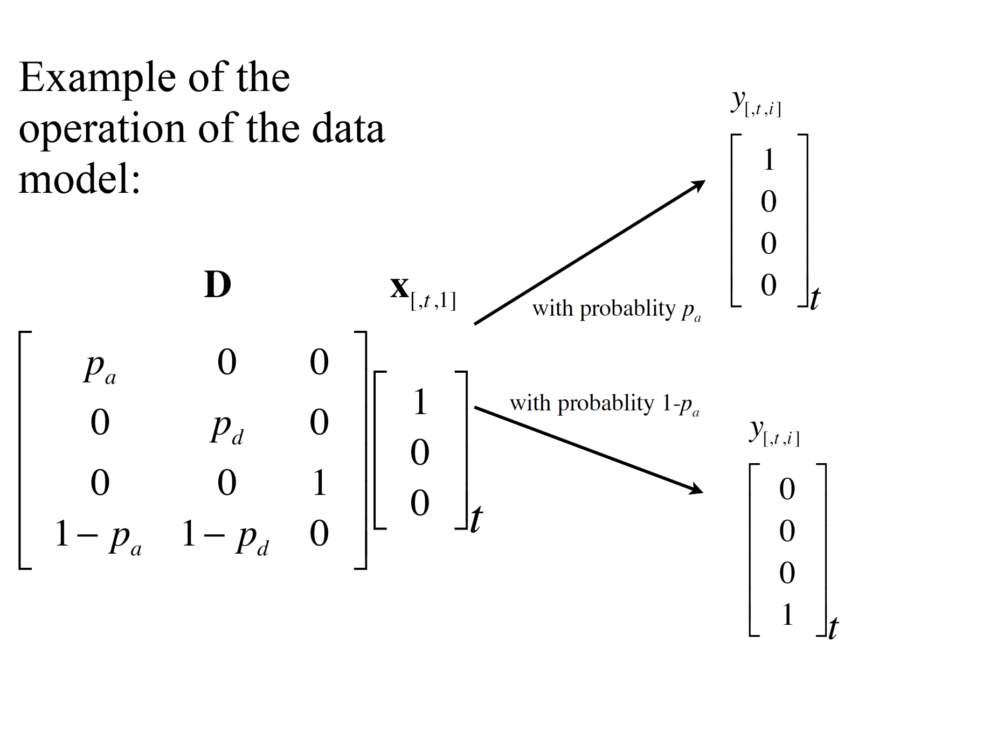
Detection

Slide 37
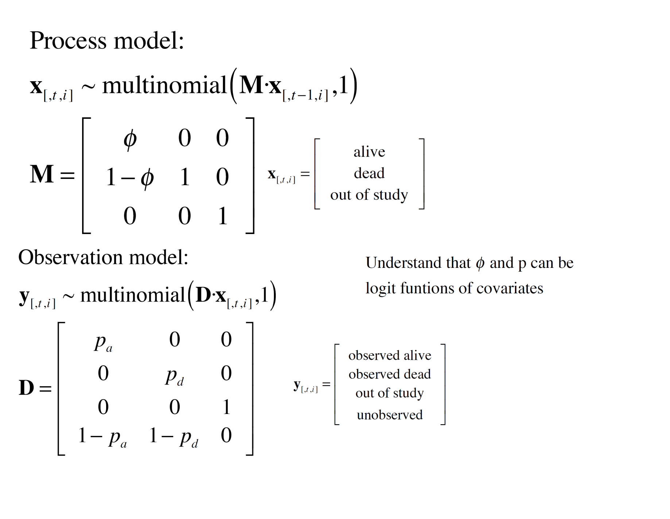

Slide 38
References
Mackenzie , Nichols and Royle (2005) Occupancy Estimation and Modeling: Inferring Patterns and Dynamics of Species Occurrence.
Kery and Schaub (2007) Bayesian Population Analysis using WinBUGS: A hierarchical perspective.
Royle and Dorazio (2008) Hierarchical Modeling and Inference in Ecology: The Analysis of Data from Populations, Metapopulations and Communities. Academic Press.

